Slide 1

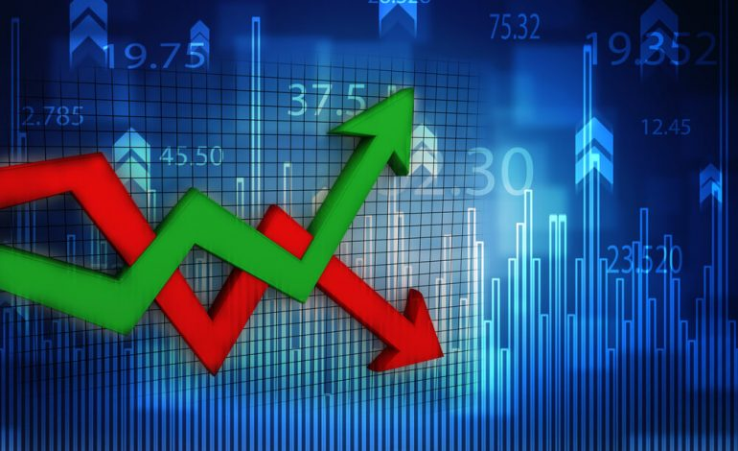
ARROW-UP CAPITAL

Slide 2
Who Are We?
Start-up FinTech Investment Company.
Mission Statement: To Advance the Financial Industry through Technology!
Investment Approach: Follow a disciplined and systematic approach to portfolio construction.
Utilize latest Software and Predictive Algorithms to rigorously analyze risk whilst seeking superior long term returns!
ARROW-UP CAPITAL

Slide 3
Meet the Team
Chris Ringwood
Enterprise Solutions and Technology
Abuzar Fakhruddin
Trading and Portfolio Mgmnt
Saibal Saha
Research and Quant Development
Desi Reddy
Risk and Compliance
Aizhen Dong
CEO and Investments

Slide 4
Why are We Here?
Objective: Demonstrate our in-house Portfolio Optimizer App.
Research Question: Would an Optimally constructed portfolio of High Cap stocks perform better than a similarly constructed portfolio of Low Cap stocks over the last year (Sep-21 to Sep-22)?
ARROW-UP CAPITAL

Slide 5
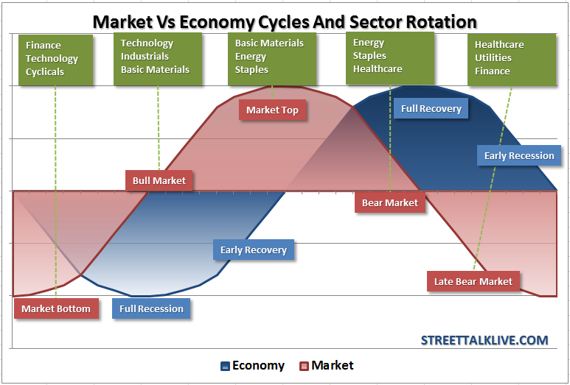
Portfolio Optimizer - Investigated Optimal Weighted Portfolio for High and Low Cap Stock Against the DOW
Financial Markets – Business and Financial Cycles
Sector Rotation
ARROW-UP CAPITAL

Slide 6
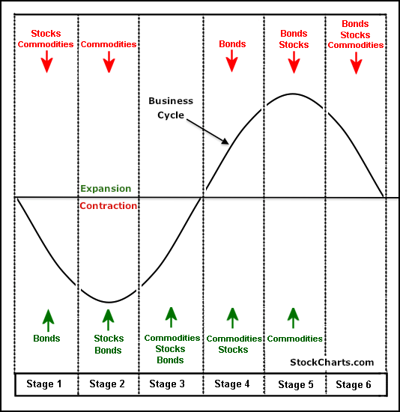
Portfolio Optimizer - Investigated Optimal Weighted Portfolio for High and Low Cap Stock Against the DOW
Sector Rotation Analysis attempts to link current strengths and weaknesses in the stock market with the general business cycle based on the relative performance of the eleven S&P Sector SPDR ETFs.
Sector Rotation Analysis attempts to link current strengths and weaknesses in the stock market with the general business cycle based on the relative performance of the eleven S&P Sector SPDR ETFs.
ARROW-UP CAPITAL

Slide 7
Portfolio Optimizer - Investigated Optimal Weighted Portfolio for High and Low Cap Stock Against the DOW
Selection of Stocks
Our Selection based on the idea of Business/ Financial Cycles and Sector Rotation. We picked Top 5 Stocks which has highest market Capitalization and Top 5 Stocks which has Lowest market Capitalization. The sectors are randomly selected and common between both Portfolios. We compared each Portfolio with our benchmark DJIA.
ARROW-UP CAPITAL

Slide 8
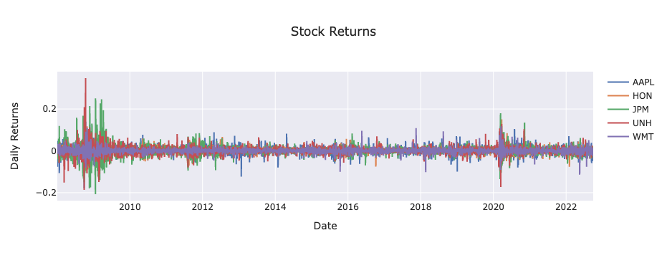
Portfolio Optimizer - Investigated Optimal Weighted Portfolio for High and Low Cap Stock Against the DOW
Back-testing Period Rationale
2008 - Subprime Mortgage Crisis
2020 – Covid-19 Pandemic
ARROW-UP CAPITAL

Slide 9
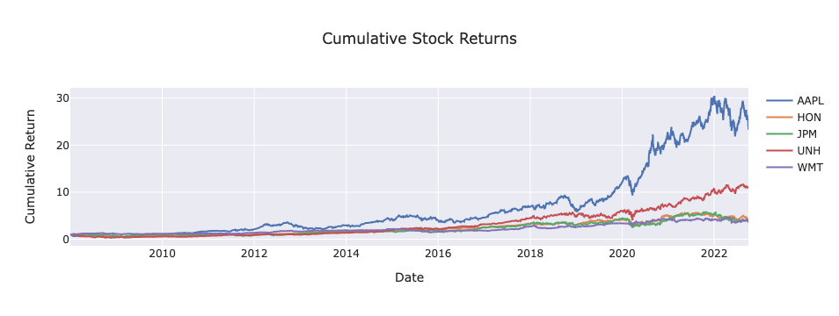
Portfolio Optimizer - Investigated Optimal Weighted Portfolio for High and Low Cap Stock Against the DOW (2008-2021/2022)
PROCESS STEP 1 (Pull Data – API + Data Cleaning)
Financial data was pulled from Yahoo API.
Set import libraries & user defined variables (i.e. sorted stock list, start_date, end_date, number_opt_portfolios, MC simulation variables, etc.).
Created a dataframe of closing stock prices for top 5 high mcap DJI stocks plus the DJI benchmark index. Used pct_change formula to calculate daily stock returns in a stored dataframe.
Generated daily returns , cumulative returns, box, and a distribution plot using Plotly library for all 5 stocks + the DJI benchmark index.
ARROW-UP CAPITAL

Slide 10
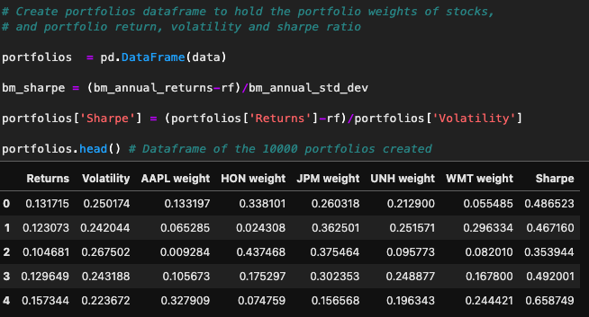
Portfolio Optimizer - Investigated Optimal Weighted Portfolio for High and Low Cap Stock Against the DOW (2008-2021/2022)
PROCESS STEP 2 (Calculate Optimal Portfolio Weights)
Created covariance & correlation matrices from the original dataframes. Converted the benchmark and 5 hi-cap returns into normalized annual returns using the CAGR (compound annual growth rate) function. The volatility (annual std dev) was then calculated. Both annualized returns and volatility were concatenated into their own two column dataframe. Empty lists instantiated to hold p_ret[] (portfolio returns values), p_vol[] (portfolio volatility values), and finally a list to hold soon to be a series of p_weights[]
'For-each' loop initiated to iterate through the set number of simulated portfolios with variable randomized weighting:(weights = np.random.random(num_assets)). Next, created a normalized list of weights corresponding to the equivalent number of assets in a set portfolio (in this case 5). The dot product of the weights array and annualized return for each iteration is then appended into the p_ret[] list (weighted returns list). Initial cov_matrix is used to calculate variance for each iteration & converted to 'volatility'.
Finally, a dataframe is created where each hypothetical test portfolio is indexed with p_ret[] (portfolio returns value), p_vol[] (portfolio volatility value) & 5 individual hi-cap stock weights as column headers. Additionally, a final column includes an appended Sharpe's Ratio calculated upon each iteration.
ARROW-UP CAPITAL

Slide 11
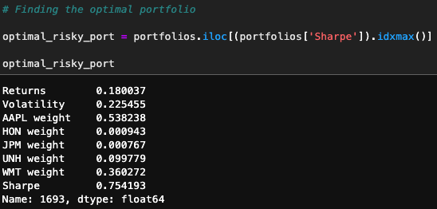
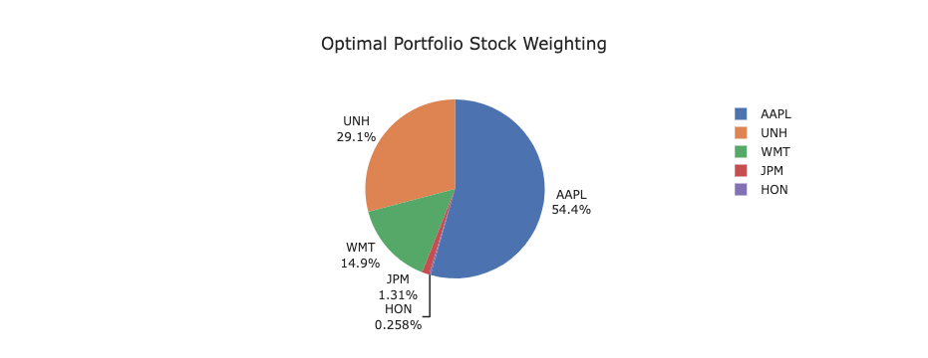
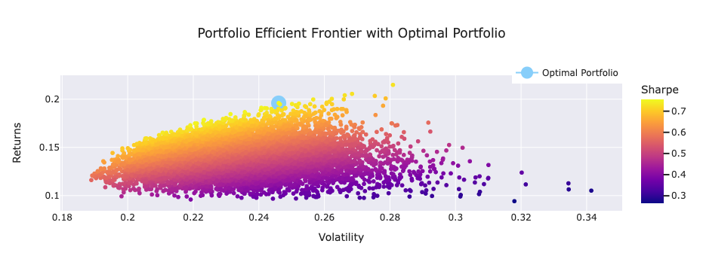
Portfolio Optimizer - Investigated Optimal Weighted Portfolio for High and Low Cap Stock Against the DOW (2008-2021/2022)
PROCESS STEP 2 (Calculate Optimal Portfolio Weights)
Utilized.idmax to locate maximum Sharpe Ratio value & index, and hence optimal portfolio for maximum returns with acceptable risk. Then, generated a scatter plot for the entire hi-cap dataframe data to visualize all hypothetical simulated portfolio returns & the efficient frontier.
ARROW-UP CAPITAL

Slide 12
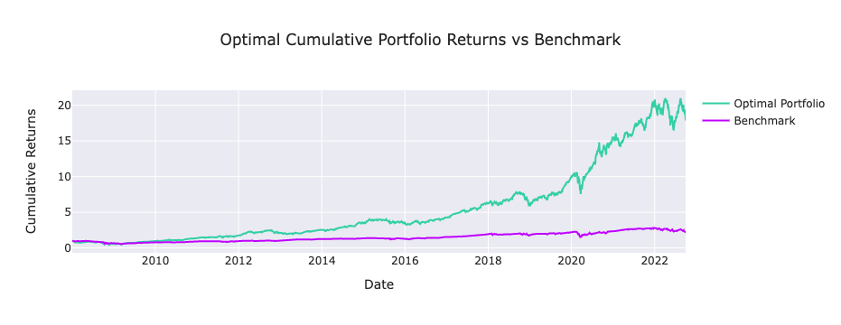
Portfolio Optimizer - Investigated Optimal Weighted Portfolio for High and Low Cap Stock Against the DOW (2008-2021/2022)
PROCESS STEP 3 (Calculated Optimal Portfolio Returns vs. Benchmark / 'Out-of-Sample' Testing)
Now that we had calculated the optimal portfolio weighting, we historically tested the results by creating a daily returns portfolio for optimal weighting & plotted the cumulative portfolio returns (from 2008-Present).
Calculated a full descriptive data statistics table on the historical data and ran a Monte Carlo Sim on the results 5 years out.
Moreover, as an experiment, we created an optimal portfolio weighting based on historical data - excluding the last 252 trading days. We then ran this as an 'out of sample' data model against the benchmark DJI to see how it performed for the past year.
Finally, we repeated all the previous steps to calculate the optimal portfolios based on the lowest market cap stocks included in the DJI indices (again, all stocks were chosen from unique 'industry groups' within the index itself). This was to see how a low-cap optimal portfolio performed against the initial hi-cap experiment.
ARROW-UP CAPITAL

Slide 13
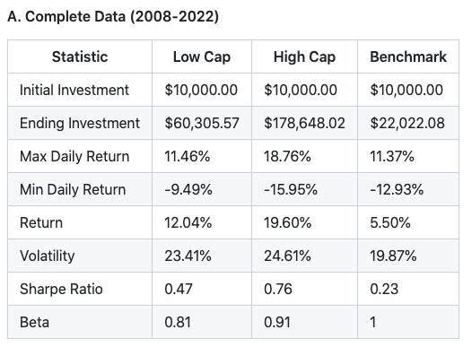
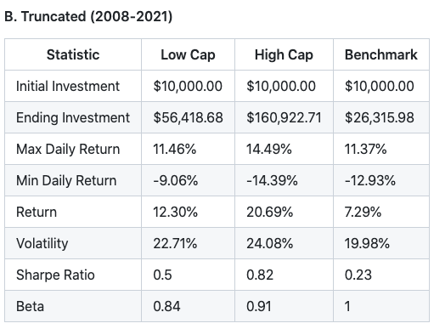
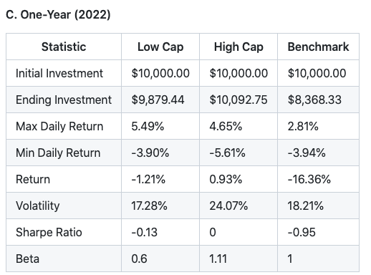
Portfolio Optimizer - Investigated Optimal Weighted Portfolio for High and Low Cap Stock Against the DOW - CONCLUSION
TEMPLATE SLIDE
ARROW-UP CAPITAL
ARROW-UP CAPITAL

Slide 14
Corporate Gift!!
https://bit.ly/3TbYbPC
ARROW-UP CAPITAL

Slide 15

THANK YOU!!
ARROW-UP CAPITAL

Slide 16
Questions?
ARROW-UP CAPITAL

